Slide 1
CHAP#7
REQUIREMENTS MODELING: FLOW, BEHAVIOR, PATTERNS, AND WEBAPPS

Slide 2
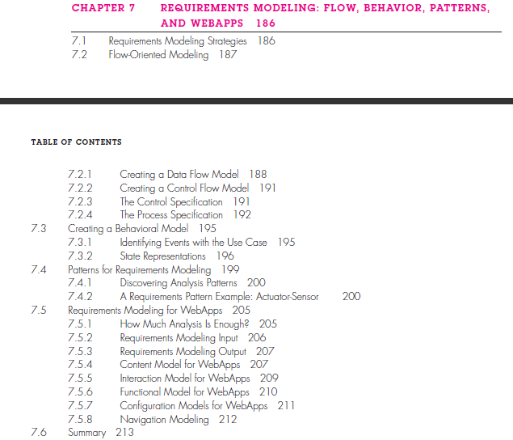

Slide 3
Introduction
For some types of software, the use case may be the only requirements modeling representation that is required.
For others, an object-oriented approach is chosen and class-based models may be developed.
But in other situations, complex application requirements may demand an examination of how data objects are transformed as they move through a system.

Slide 4
7.1 REQUIREMENTS MODELING STRATEGIES
One view of requirements modeling, called structured analysis, considers data and the processes that transform the data as separate entities.
Data objects are modeled in a way that defines their attributes and relationships.
Processes that manipulate data objects are modeled in a manner that shows how they transform data as data objects flow through the system.
Object-oriented analysis, focuses on the definition of classes and the manner in which they collaborate with one another to effect customer requirements.
Although the analysis model that we propose in this book combines features of both approaches, software teams often choose one approach and exclude all representations from the other.
Combination of representations will provide stakeholders with the best model of software requirements and the most effective bridge to software design.

Slide 5
7.2 Flow-Oriented Modeling
data flow diagram (DFD) and related diagrams and information are not a formal part of UML, they can be used to complement UML diagrams and provide additional insight into system requirements and flow.
The DFD takes an input-process-output view of a system. That is, data objects flow into the software, are transformed by processing elements, and resultant data objects flow out of the software.
Data objects are represented by labeled arrows, and transformations are represented by circles (also called bubbles).
First data flow model (sometimes called a level 0 DFD or context diagram) represents the system as a whole. Subsequent data flow diagrams refine the context diagram, providing increasing detail with each subsequent level(Diagram from book).

Slide 6
7.2.1 Creating a Data Flow Model
The data flow diagram enables you to develop models of the information domain and functional domain.
DFD refinement results in a corresponding refinement of data as it moves through the processes that embody the application.
A few simple guidelines can aid immeasurably during the derivation of a data flow diagram:
(1) the level 0 data flow diagram should depict the software/system as a single bubble;
(2) primary input and output should be carefully noted;
(3) refinement should begin by isolating candidate processes, data objects, and data stores to be represented at the next level;
(4) all arrows and bubbles should be labeled with meaningful names;
(5) information flow continuity must be maintained from level to level,2 and
(6) one bubble at a time should be refined.
The grammatical parse is not foolproof, but it can provide you with an excellent jump start, if you’re struggling to define data objects and the transforms that operate on them.

Slide 7
7.2.2 Creating a Control Flow Model
Obtain meaningful insight into software requirements.
Heavy concern for time and performance. Such applications require the use of control flow modeling in addition to data flow modeling.
Event or control item is implemented as a Boolean value (e.g., true or false, on or off, 1 or 0) or a discrete list of conditions (e.g., empty, jammed, full).
List all things read by software, interrupt conditions, “switches”, data conditions, noun/verb parse, identifying its states, identify how each state is reached, define the transitions between states, Focus on possible omissions(Stuck cases).

Slide 8
7.2.3 The Control Specification
A control specification (CSPEC) represents the behavior of the system in two different ways.
The CSPEC contains a state diagram that is a sequential specification of behavior. It can also contain a program activation table—a combinatorial specification of behavior.
State diagram indicates that the transitions from the Idle state can occur if the system is reset, activated, or powered off.
Behavioral representation is the process activation table. The PAT represents information contained in the state diagram in the context of processes, not states. That is, the table indicates which processes in the flow model will be invoked when an event occurs. The PAT can be used as a guide for a designer.

Slide 9
7.2.4 The Process Specification
The process specification (PSPEC) is used to describe all flow model processes that appear at the final level of refinement.
The content of the process specification can include narrative text, a program design language (PDL) description of the process algorithm, mathematical equations, tables, or UML activity diagrams.
Guide for design of the software component that will implement.

Slide 10
7.3 Creating Behavioral Model
Discussed to this point represents static elements of the requirements model. It is now time to make a transition to the dynamic behavior of the system or product.
The behavioral model indicates how software will respond to external events.
To create the model, you should perform the following steps:
1. Evaluate all use cases to fully understand the sequence of interaction within
the system.
2. Identify events that drive the interaction sequence and understand how these
events relate to specific objects.
3. Create a sequence for each use case.
4. Build a state diagram for the system.
5. Review the behavioral model to verify accuracy and consistency.

Slide 11
7.3.1 Identifying Events with the Use Case
Use case represents a sequence of activities that involves actors and the system. In general, an event occurs whenever the system and an actor exchange information.
Underlined portions of the use case scenario indicate events. An actor should be identified for each event; the information that is exchanged should be noted, and any conditions or constraints should be listed. Once all events have been identified, they are allocated to the objects involved. Objects can be responsible for generating events.

Slide 12
7.3.2 State Representations
In the context of behavioral modeling, two different characterizations of states must be considered: (1) the state of each class as the system performs its function and (2) the state of the system as observed from the outside as the system performs its function.
A passive state is simply the current status of all of an object’s attributes. The active state of an object indicates the current status of the object as it undergoes a continuing transformation or processing. An event (sometimes called a trigger) must occur to force an object to make a transition from one active state to another.
State diagrams for analysis classes: represents active states for each class and the events (triggers) that cause changes between these active states. A guard is a Boolean condition that must be satisfied in order for the transition to occur. An action occurs concurrently with the state transition or as a consequence of it and generally involves one or more operations (responsibilities) of the object.
Sequence diagrams: indicates how events cause transitions from object to object. Modeler creates a sequence diagram. Time is measured vertically (downward), and the narrow vertical rectangles represent time spent in processing an activity.

Slide 13
7.4 Patterns for Requirements Modelling
Software patterns are a mechanism for capturing domain knowledge in a way that allows it to be reapplied when a new problem is encountered. Domain knowledge is applied to a new problem within the same application domain.
The original author of an analysis pattern does not “create” the pattern, but, rather, discovers it as requirements engineering work is being conducted. Once the pattern has been discovered, it is documented.
Analysis patterns are stored in a repository so that members of the software team can use search facilities to find and reuse them. Once an appropriate pattern is selected, it is integrated into the requirements model by reference to the pattern name.

Slide 14
7.4.1 Discovering Analysis Patterns
The requirements model is comprised of a wide variety of elements: scenario-based (use cases), data-oriented (the data model), class-based, flow-oriented, and behavioral.Each of these elements examines the problem from a different perspective, and each provides an opportunity to discover patterns that may occur throughout an application domain.
The most basic element in the description of a requirements model is the use case. A semantic analysis pattern (SAP) is a pattern that describes a small set of coherent use cases that together describe a basic generic application.
The “actuator” is the breaking system of the vehicle (invoked if an object is very close to the vehicle).

Slide 15
7.5 Requirements Modeling For WebApps
Web development process must be agile, and analysis is time consuming.
7.5.1 How Much Analysis Is Enough?
• Size and complexity of WebApp increment.
• Number of stakeholders (analysis can help to identify conflicting requirements coming from different sources).
• Size of the WebApp team.
• Degree to which members of the WebApp team have worked together before (analysis can help develop a common understanding of the project).
• Degree to which the organization’s success is directly dependent on the success of the WebApp.

Slide 16
7.5.2 Requirements Modeling Input
An agile version of the generic software process can be applied when WebApps are engineered.
The process incorporates a communication activity that identifies stakeholders and user categories, the business context, defined informational and applicative goals, general WebApp requirements, and usage scenarios.
This information is represented in the form of natural language descriptions, rough outlines,sketches, and other informal representations.
Structures it using a formally defined representation scheme.
The requirements model provides a detailed indication of the true structure of the problem and provides insight into the shape of the solution.
Requirements analysis refines this understanding by providing additional interpretation.

Slide 17
7.5.3 Requirements Modeling Output
Requirements analysis provides a disciplined mechanism for representing and evaluating WebApp content and function, the modes of interaction that users will encounter, and the environment and infrastructure in which the WebApp resides.
Five main classes of models:
• Content model—identifies the full spectrum of content to be provided by the WebApp. Content includes text, graphics and images, video, and audio data.
• Interaction model—describes the manner in which users interact with the WebApp.
• Functional model—defines the operations that will be applied to WebApp content and describes other processing functions that are independent of content but necessary to the end user.
• Navigation model—defines the overall navigation strategy for the WebApp.
• Configuration model—describes the environment and infrastructure in which the WebApp resides.

Slide 18
7.5.4 Content Model for WebApps
The content model contains structural elements that provide an important view of content requirements for a WebApp.
These structural elements encompass content objects and all analysis classes.
The content objects might be stored as separate files, embedded directly into Web pages, or obtained dynamically from a database.

Slide 19
7.5.5 Interaction Model for WebApps
This conversation can be described using an interaction model that can be composed of one or more of the following elements: (1) use cases, (2) sequence diagrams, (3) state diagrams,16 and/or (4) user interface prototypes.
User-WebApp connections have much to do with user satisfaction and the overall success of the WebApp.
The prototype should implement the major navigational links and represent the overall screen layout in much the same way that it will be constructed.

Slide 20
7.5.6 Functional Model for WebApps
Requirements must be analyzed, and when necessary, modeled.
The functional model addresses two processing elements of the WebApp, each representing a different level of procedural abstraction: (1) user-observable functionality that is delivered by the WebApp to end users, and (2) the operations contained within analysis classes that implement behaviors associated with the class.
At a lower level of procedural abstraction, the requirements model describes the processing to be performed by analysis class operations. These operations manipulate class attributes and are involved as classes collaborate with one another to accomplish some required behavior.
At the analysis level, activity diagrams should be used only where the functionality is relatively complex.

Slide 21
7.5.7 Configuration Models for WebApps
configuration model is nothing more than a list of server-side and client-side attributes.
distributing load among multiple servers, caching architectures, remote databases, multiple servers serving various objects on the same Web page.

Slide 22
7.5.8 Navigation Modeling
Navigation modeling considers how each user category will navigate from one WebApp element (e.g., content object) to another. At this stage, you should focus on overall navigation requirements.
Will a user be able to access content objects or functions based on defined attributes of those elements.

